Slide 1
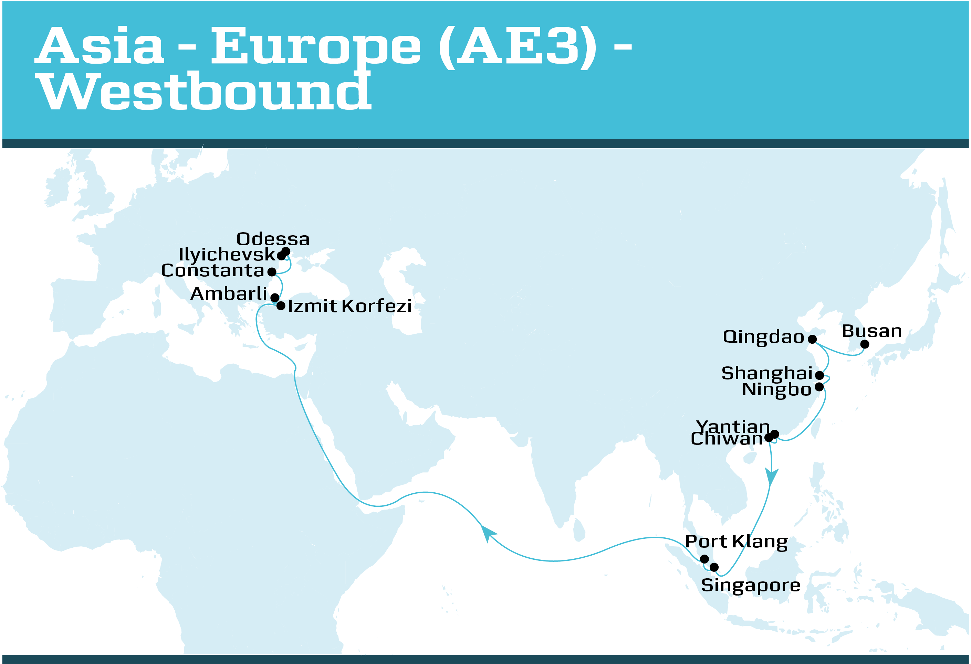
Asia-Mediterranean (AE3) – Westbound
SERVICE HIGHLIGHTS
Service offers unique North China and Korea coverage benefitting customers shipping auto parts, furniture, frozen seafood and electronics Excellent transit times from East China, South China and South East Asia to Turkey and Black Sea One of two direct services into Ambarli Reliable connection from the Far East into Novorossiysk, Russia via Ambarli Provides flexibility and unique advantage to customers with 2 port calls into Ukraine on the AE3 service
TRANSIT TIME MATRIX
DEPARTS | ARRIVES
 | Izmit Korfezi | Ambarli Port, Istanbul | Constanta | Odessa | Ilyichevsk
Busan, South Korea | 27 | 28 | 30 | 32 | 34
Qingdao, China | 25 | 26 | 28 | 30 | 32
Shanghai, China | 23 | 25 | 26 | 28 | 31
Ningbo, China | 22 | 24 | 25 | 27 | 30
Yantian, China | 20 | 21 | 23 | 25 | 27
Chiwan, China | 19 | 20 | 22 | 24 | 26
Singapore, Singapore | 15 | 16 | 18 | 20 | 22
Port Klang, Malaysia | 13 | 15 | 16 | 18 | 21

Slide 2
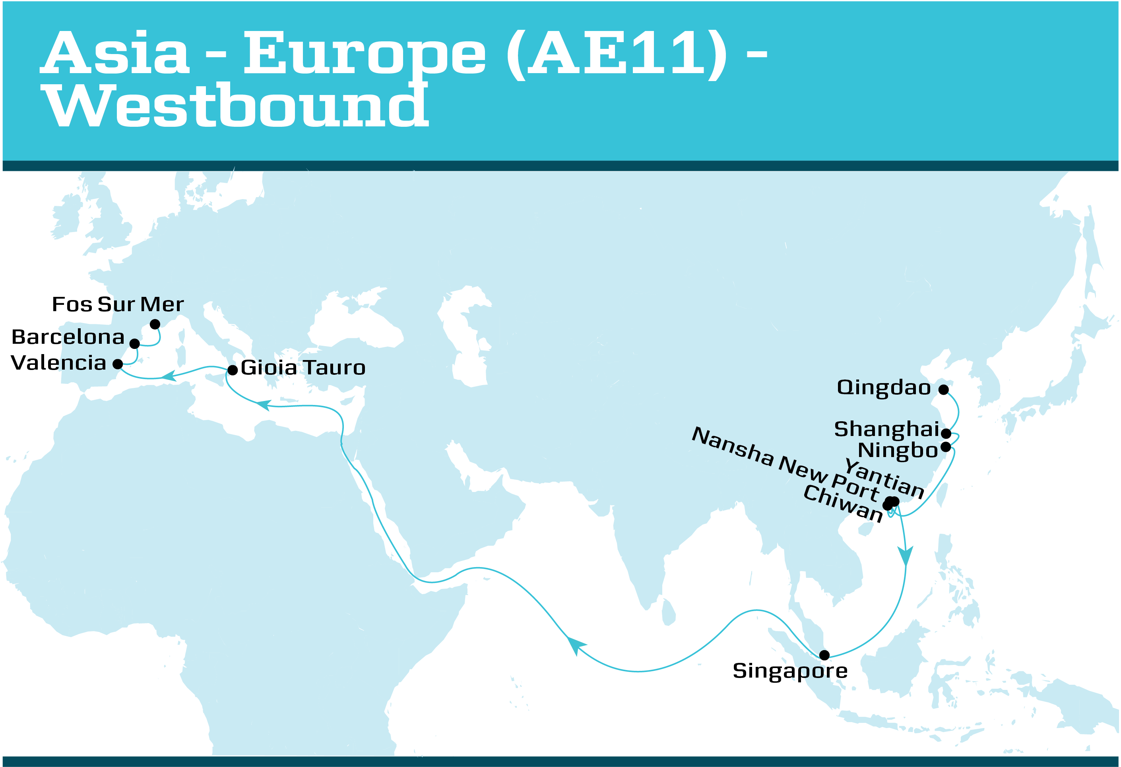
Asia-Mediterranean (AE11) – Westbound
SERVICE HIGHLIGHTS
Offers unique North China to West Mediterranean coverage on the largest vessel type ever deployed in Mediterranean Excellent transit times from the South China ports of Nansha, Chiwan, Yantian into Spain Market’s fastest transit times from South China to Valencia and Algeciras via a dedicated call on the US East Coast service (TP13) Continues to service the Italy and Spain market with two separate dedicated services (AE11 and AE20) Unique double call (twice a week) into Fos Sur Mer (France) from a wide range of origin ports Competitive product into South Italy via Gioia Tauro
TRANSIT TIME MATRIX
DEPARTS | ARRIVES
 | Gioia Tauro | Valencia | Barcelona | Fos sur Mer
Qingdao, China | 28 | 31 | 33 | 35
Shanghai, China | 26 | 29 | 31 | 33
Ningbo, China | 25 | 28 | 30 | 32
Nansha, China | 22 | 25 | 27 | 29
Chiwan, China | 21 | 24 | 26 | 28
Yantian, China | 20 | 22 | 25 | 27
Singapore, Singapore | 15 | 18 | 20 | 22

Slide 3
Asia-Mediterranean (AE12) – Westbound
SERVICE HIGHLIGHTS
Service offers the best Korea and East and South China to the Adriatic coverage benefitting customers shipping auto and electronics Provides a gateway to Central & Eastern Europe via Adriatic Excellent transit times from Busan, Shanghai, Ningbo & Hong Kong to Koper
TRANSIT TIME MATRIX
DEPARTS | ARRIVES
 | Port Said | Koper | Trieste | Rijeka
Busan, South Korea | 25 | 29 | 31 | 33
Ningbo, China | 22 | 26 | 28 | 31
Shanghai, China | 21 | 25 | 27 | 30
Hong Kong, Hong Kong | 19 | 23 | 25 | 27
Chiwan, China | 18 | 22 | 24 | 26
Yantian, China | 17 | 21 | 23 | 26
Singapore, Singapore | 12 | 16 | 18 | 21

Slide 4
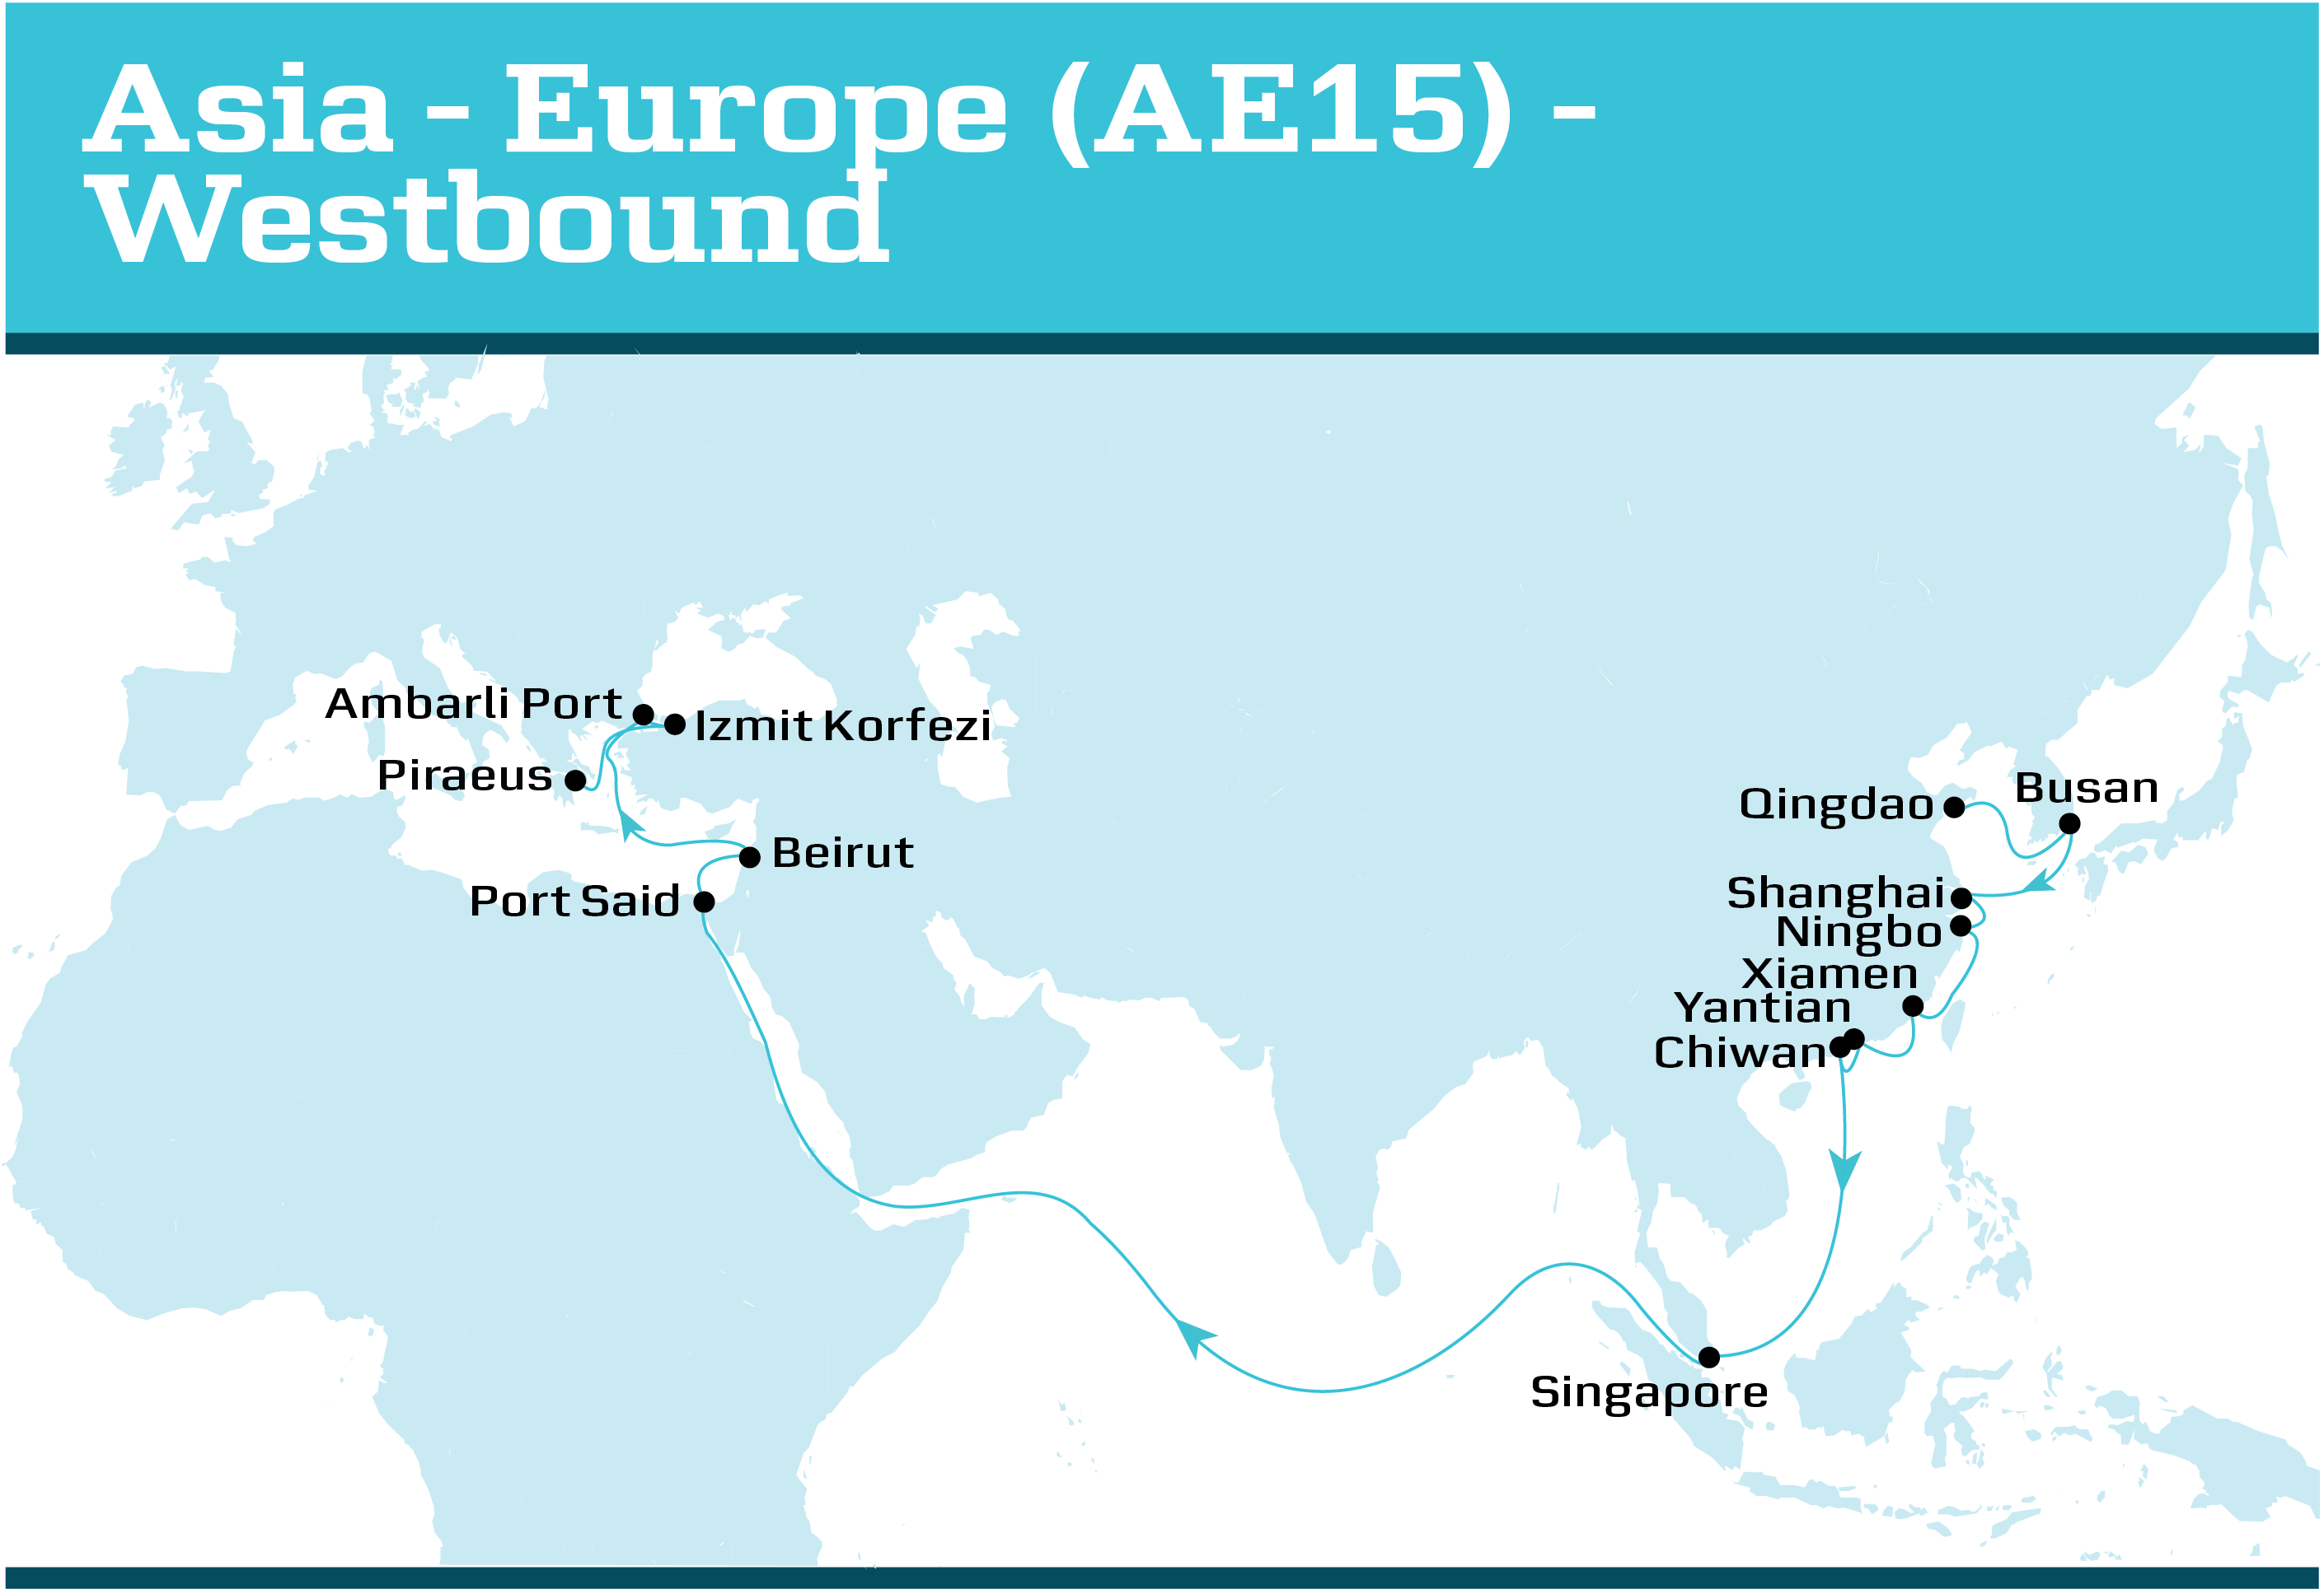
Asia-Mediterranean (AE15) – Westbound
SERVICE HIGHLIGHTS
Offers North China and Korea coverage with a call in Xiamen benefitting customers shipping auto parts, furniture, frozen seafood and electronics Excellent transit times from East China, South China and South East Asia to Ambarli, Port Said and Beirut Additional AE15 service on the trade ensures 2 weekly services into the East Mediterranean market One of two direct services into Ambarli Reliable connection from the Far East into Novorossiysk, Russia via Ambarli
TRANSIT TIME MATRIX
DEPARTS | ARRIVES
 | Port Said | Beirut | Ambarli Port, Istanbul | Izmit Korfezi | Piraeus
Qingdao, China | 25 | 27 | 30 | 33 | 35
Busan, South Korea | 24 | 25 | 29 | 31 | 33
Shanghai, China | 21 | 23 | 26 | 29 | 31
Ningbo, China | 20 | 22 | 25 | 28 | 30
Xiamen, China | 18 | 20 | 23 | 26 | 28
Yantian, China | 17 | 18 | 22 | 24 | 26
Chiwan, China | 16 | 17 | 21 | 23 | 25
Singapore, Singapore | 11 | 13 | 16 | 18 | 21

Slide 5
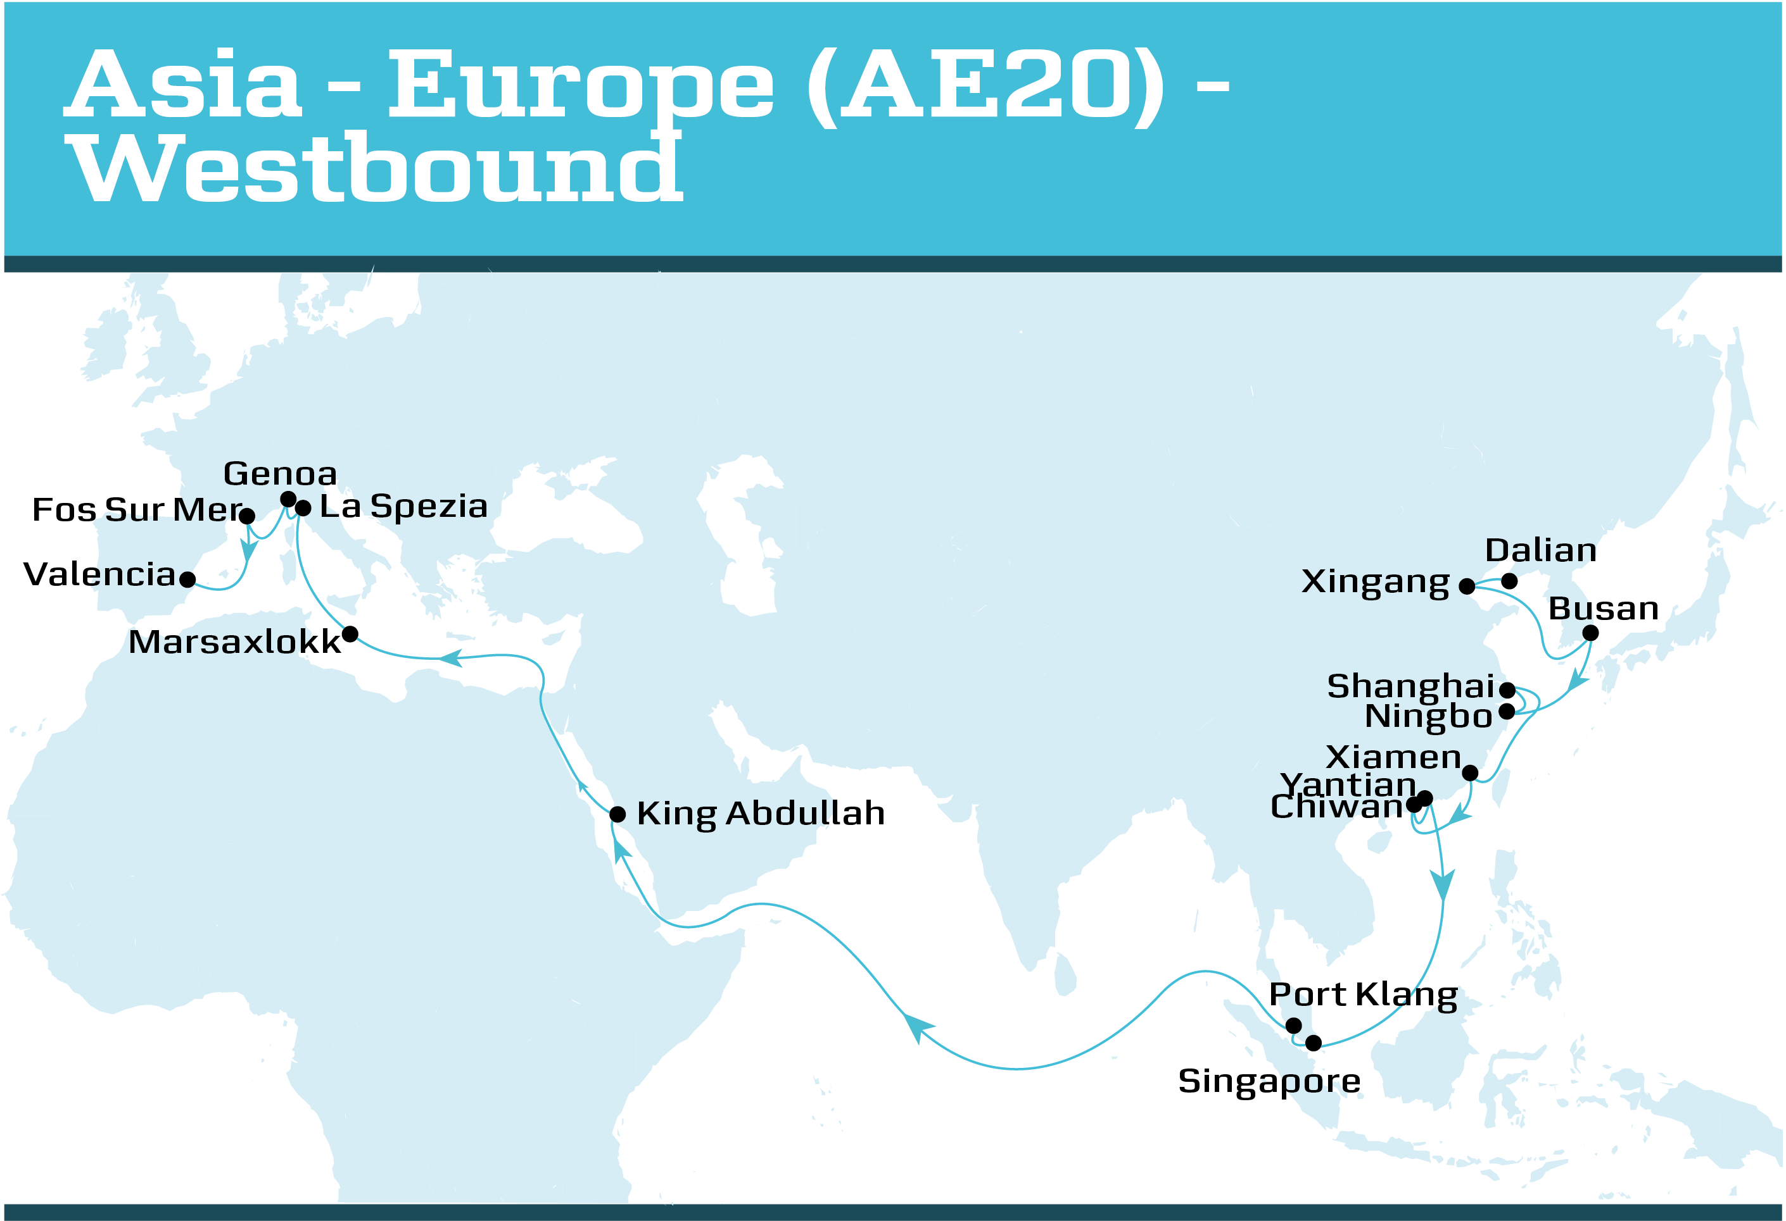
Asia-Mediterranean (AE20) – Westbound
SERVICE HIGHLIGHTS
Offers extensive China and South Korea coverage into Italy Excellent transit times from Shanghai, Ningbo and Chiwan, Yantian to North Africa and West Mediterranean benefits retail customers speed up their supply chain Offers unique double-loop and addition of North China and South Korea to West Mediterranean coverage with the AE20 and AE11 Competitive transit times from all main Asia ports to North Africa
TRANSIT TIME MATRIX *Showcases only Asia-Mediterranean
DEPARTS | ARRIVES
 | Marsaxlokk | La Spezia | Genoa | Fos sur Mer | Valencia
Dalian, China | 31 | 34 | 35 | 37 | 39
Xingang, China | 29 | 32 | 34 | 36 | 38
Busan, South Korea | 27 | 30 | 31 | 33 | 35
Ningbo, China | 25 | 28 | 29 | 31 | 33
Shanghai, China | 24 | 26 | 28 | 30 | 32
Xiamen, China | 22 | 25 | 26 | 28 | 30
Chiwan, China | 20 | 23 | 25 | 27 | 29
Yantian, China | 20 | 22 | 24 | 26 | 28
Singapore, Singapore | 15 | 18 | 20 | 22 | 24
Port Klang, Malaysia | 14 | 17 | 18 | 20 | 22

