Slide 1
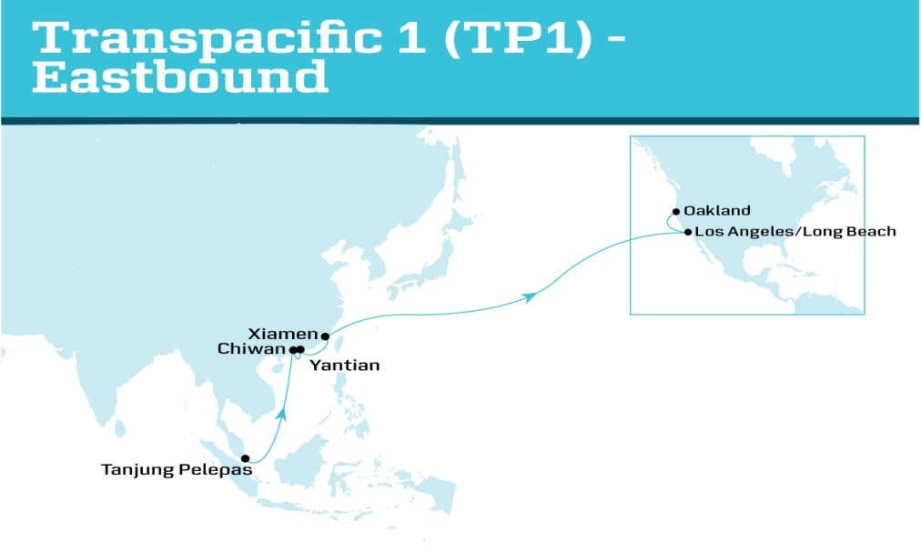
Transpacific 1 (TP1) – Eastbound
SERVICE HIGHLIGHTS
TP1 offers a solution from South China to Southern California, catering to the needs of the continually growing furniture, machinery and textile markets. Direct product from Xiamen ensures further improvement of transit time providing additional options for the growing East China market. One of two weekly Yantian sailings (the other being TP6) will allow customers, such as those in the furniture markets, the option to work within their production schedules. With 2 South China port calls – Chiwan and Yantian –customers can optimise their local haulage to either port depending on where facilities are located throughout the Shenzhen province. Chiwan solution directly connects to China Coastal Highway and Nanping highways, easily linking you to your warehousing and production facilities.
TRANSIT TIME MATRIX
DEPARTS | ARRIVES
 | Los Angeles / Long Beach | Oakland
Tanjung Pelepas, Malaysia | 21 | 25
Chiwan, China | 16 | 20
Yantian, China | 14 | 18
Xiamen, China | 13 | 16

Slide 2
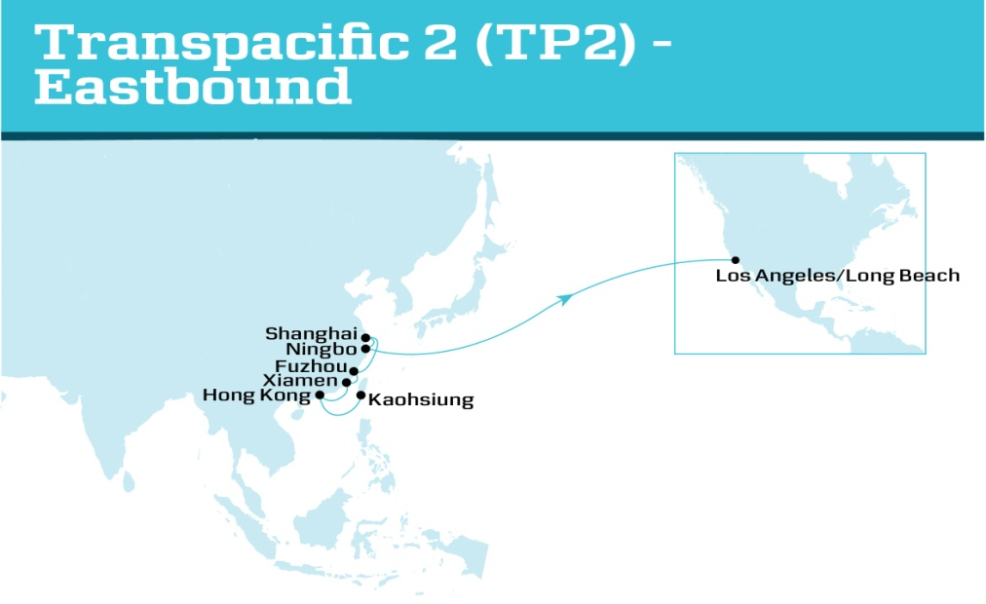
Transpacific 2 (TP2) – Eastbound
SERVICE HIGHLIGHTS
Now offering an East China to Southern California product which will cover more than 90% of the fastest growing and largest market in China. The new addition of Fuzhou provides a great link to inland solutions for Western and South Eastern China through a developing partnership with inland hubs The TP2 will be enhanced to utilise larger vessels and thereby provides customers opportunity to grow business further.
TRANSIT TIME MATRIX
DEPARTS | ARRIVES
 | Los Angeles / Long Beach
Kaohsiung, Taiwan | 21
Hong Kong, Hong Kong | 19
Xiamen, China | 18
Fuzhou, China | 16
Shanghai, China | 14
Ningbo, China | 12

Slide 3
Transpacific 5 (TP5) – Eastbound
SERVICE HIGHLIGHTS
TP5 will continue its extensive coverage of the Japanese and South Korean markets to the US West Coast With early week arrivals into the USWC, many automobile and machinery customers from Japan and South Korea will benefit from close connections with rail solutions, as On Time Delivery is a critical component for their production lines. With 2 weekly sailings out of Qingdao to Southern California, this is one of the most competitive products for North China in the market Offers a 6-vessel fleet consisting of four US-flagged vessels
TRANSIT TIME MATRIX
DEPARTS | ARRIVES
 | Los Angeles/ Long Beach | Oakland | Dutch Harbor
Kobe, Japan | 21 | 24 | 30
Qingdao, China | 17 | 20 | 26
Kwangyang, South Korea | 14 | 17 | 23
Busan, South Korea | 13 | 16 | 22
Hakata, Japan | 13 | 16 | 22
Nagoya, Japan | 10 | 13 | 19
Yokohama, Japan | 10 | 13 | 19

Slide 4
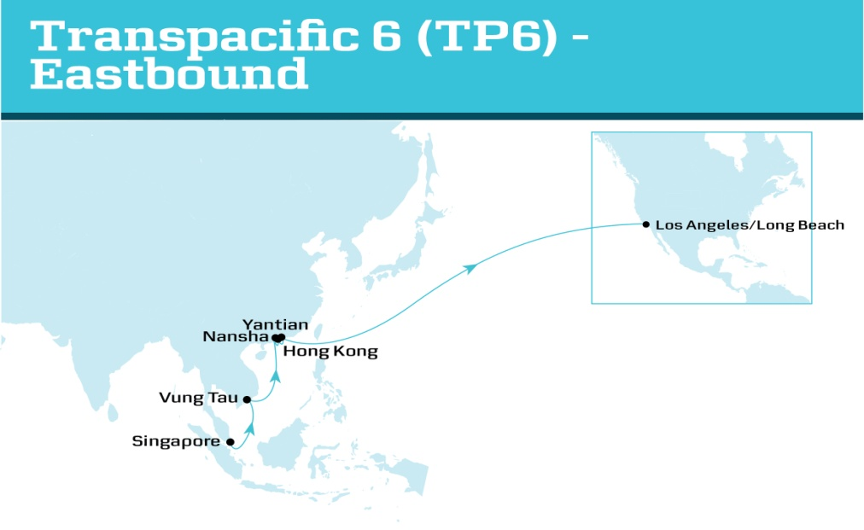
Transpacific 6 (TP6) – Eastbound
SERVICE HIGHLIGHTS
One of the largest ports in our existing network, Yantian now makes the final call in this optimised solution to Southern California Retail, Apparel and footwear customers who rely on competitive, reliable transit times and network stability will benefit from this continuing core TP6 product Direct call from Vung Tau (Vietnam) to Los Angeles /Long Beach eliminates the risk of any delays in transit for the growing furniture and apparel markets in Vietnam. One of two weekly Yantian sailings (TP1) offered, it further improves customers’ flexibility to meet the supply chain demands.
TRANSIT TIME MATRIX
DEPARTS | ARRIVES
 | Los Angeles / Long Beach
Singapore, Singapore | 21
Vung Tau, Vietnam | 18
Nansha, China | 15
Hong Kong, Hong Kong | 14
Yantian, China | 13

Slide 5
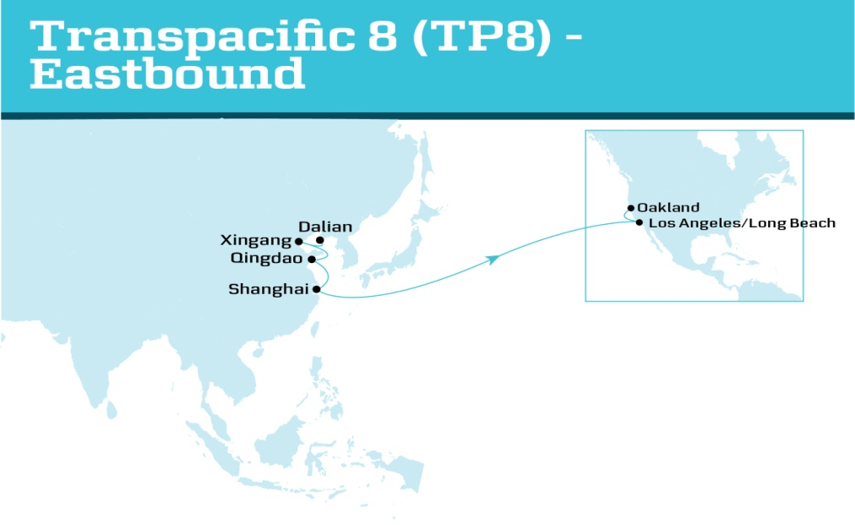
Transpacific 8 (TP8) – Eastbound
SERVICE HIGHLIGHTS
Direct coverage from North China and Shanghai to Long Beach/Los Angeles and Oakland, provides customers with the space and flexibility to grow business Customers moving furniture and electronics benefit from competitive transit times from East China to US West Coast With complete coverage of the North China market, we have an attractive solution to offer the auto-parts industry into the USWC. With 2 weekly sailings out of Northern China to Southern California, this is a highly competitive product in a growth market.
TRANSIT TIME MATRIX
DEPARTS | ARRIVES
 | Los Angeles / Long Beach | Oakland
Dalian, China | 19 | 23
Xingang, China | 17 | 21
Qingdao, China | 15 | 19
Shanghai, China | 12 | 16

Slide 6
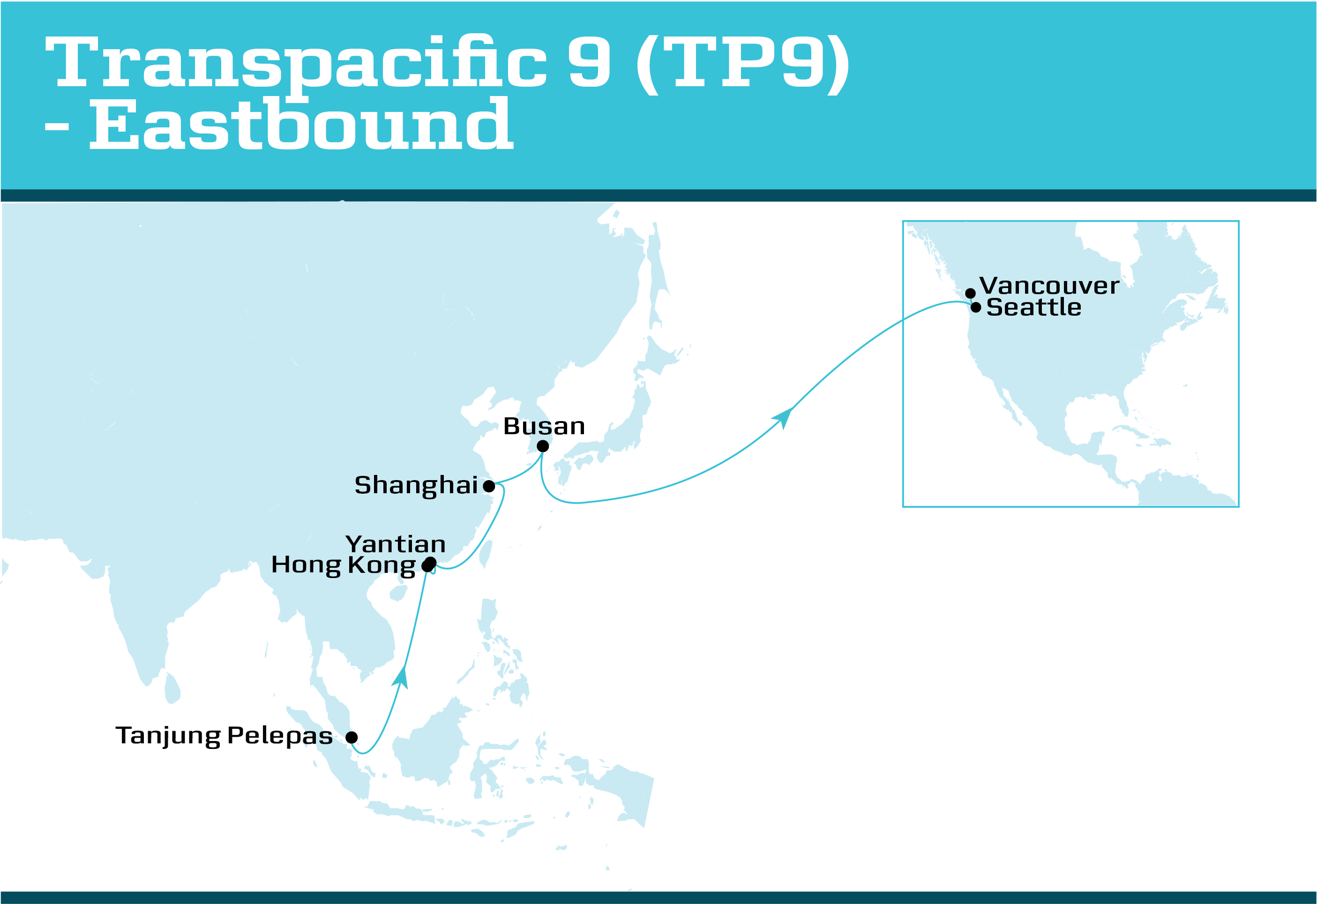
Transpacific 9 (TP9) – Eastbound
SERVICE HIGHLIGHTS
Dedicated to the Pacific Northwest and Canadian markets, the TP9 offers direct calls both at Seattle and Vancouver Reliable alternative for mid-west import customers via Canadian Rail to states such as Michigan and Ohio TP9 covers every region of Asia, from Southeast Asia feeder connections to Northern Asia, with Busan as the final call in the rotation Early week cargo availability in Vancouver ensures prime rail connections and trucking availability
TRANSIT TIME MATRIX
DEPARTS | ARRIVES
 | Seattle | Vancouver, Canada
Tanjung Pelepas, Malaysia | 21 | 24
Hong Kong, China | 16 | 19
Yantian, China | 15 | 18
Shanghai, China | 12 | 15
Busan, South Korea | 10 | 13

Slide 7
Transpacific 11 (TP11) – Eastbound
SERVICE HIGHLIGHTS
Competitive transit time out of South China to Newark and Norfolk With Yantian as the last load port, it offers a faster and direct service to the US East Coast in a growth corridor that is especially time sensitive Features 1 of 2 calls from Asia to Savannah linking key South Atlantic markets utilising the extensive rail system operated by CSX
TRANSIT TIME MATRIX
DEPARTS | ARRIVES
 | Newark | Norfolk | Savannah
Yokohama, Japan | 34 | 36 | 39
Shanghai, China | 30 | 32 | 35
Ningbo, China | 29 | 31 | 34
Hong Kong, Hong Kong | 26 | 29 | 31
Yantian, China | 25 | 28 | 30

Slide 8
Transpacific 12 (TP12) - Eastbound
SERVICE HIGHLIGHTS
Direct call in Baltimore offers the benefits of faster transit and cost efficiencies especially within the Maryland and Virginia markets A strong intermodal offering features fast and convenient access to Midwest and East Coast connections via I-95 north/south and I-70 east/west Furthering the intermodal offering, is the benefit of the CSX on-dock rail connection to major mid-west consumer markets such as Cleveland and Harrisburg A new port call at Chiwan directly connects cargo to the China Coastal Highway and Nanping highways, easily linking customers’ warehousing and production facilities to the ocean terminal A direct product from Xiamen ensures further improvement of transit times and reliability out of this growing East China port This new and additional East Coast service provides flexibility to shippers, especially during peak seasons, together with TP11 and TP13
TRANSIT TIME MATRIX
DEPARTS | ARRIVES
 | Newark | Baltimore | Norfolk | Savannah | Freeport
Shanghai, China | 34 | 36 | 37 | 39 | 42
Xiamen, China | 32 | 34 | 35 | 37 | 39
Chiwan, China | 31 | 33 | 34 | 36 | 38
Yantian, China | 29 | 31 | 32 | 35 | 37
Singapore, Singapore | 25 | 27 | 28 | 30 | 33
Salalah, Oman | 17 | 19 | 20 | 22 | 24
Haifa, Israel | 11 | 13 | 14 | 16 | 18

Slide 9
Transpacific 13 (TP13) – Eastbound
SERVICE HIGHLIGHTS
Direct call in Kaohsiung caters to Taiwanese imports such as the vehicle and appliance industries Direct calls from Shanghai and Ningbo to Newark, Charleston and Savannah enable the furniture and apparel markets to have multiple options directly into customers’ target US East Coast markets TP11, TP12 and TP13 provides customers greater coverage of the US east coast and higher frequency of sailings, which in turn means that customers have higher flexibility in their supply chain
TRANSIT TIME MATRIX
DEPARTS | ARRIVES
 | Newark | Savannah | Charleston
Kaohsiung, Taiwan | 36 | 39 | 41
Ningbo, China | 34 | 36 | 38
Shanghai, China | 32 | 35 | 37
Tanjung Pelepas, Malaysia | 26 | 29 | 31
Valencia, Spain | 8 | 11 | 13
Algeciras, Spain | 7 | 10 | 12

Slide 10
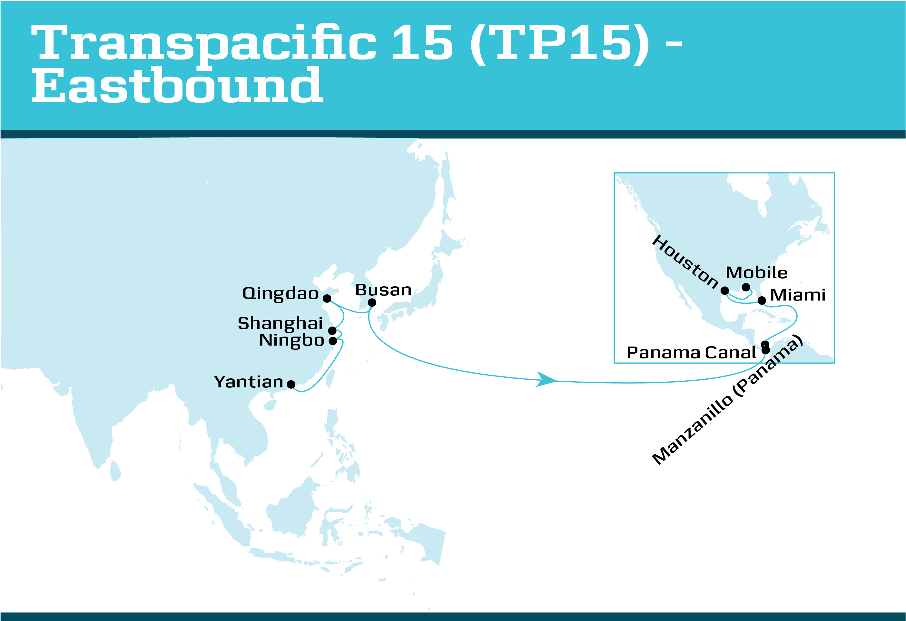
Transpacific 15 (TP15) - Eastbound
SERVICE HIGHLIGHTS
With a call in Manzanillo, Panama, the service offers great prospects for connecting to other markets, including South America, Europe and Middle East. Better transit times from North East Asia and the growing market in North China with a direct Qingdao call Provides opportunities to route cargo to Houston via all-water, versus traditional rail routing from US West coast An all water route to Houston* is further facilitated by 9 inbound, 3 outbound gates Near dock rail service Our new all-water Asia to Mobile corridor allows for inland connections via access to class 1 railroads and other benefits including Efficient gate and yard operations with state of the art container handling equipment provides faster turn times 16 gate lanes including OOG service In close proximity to major highways: I-10 and I-65 allows for easy connection to inland road network
TRANSIT TIME MATRIX
DEPARTS | ARRIVES
 | Manzanillo | Miami | Houston | Mobile
Yantian, China | 25 | 29 | 32 | 34
Ningbo, China | 23 | 26 | 29 | 31
Shanghai, China | 22 | 25 | 28 | 30
Qingdao, China | 20 | 24 | 27 | 29
Busan, South Korea | 18 | 22 | 25 | 27
Manzanillo, Panama | - | 2 | 5 | 7

