Slide 1
EVERGREEN
Far East / North Europe
Service Scope
Update 20/Mar/2014

Slide 2
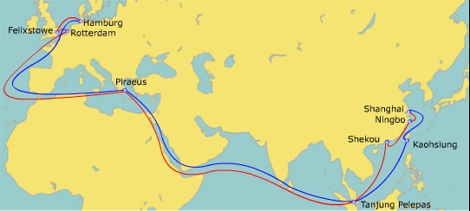
Routing Network
China-Europe-Mediterranean Service (CEM)(NE5)
PORT | TERMINAL | ETA | ETD
KSG SHG NBO XHK PTP | EMCT Kaohsiung Container Terminal (K116-K117) Shanghai Guan dong International(Yangshan) Ningbo Yining Terminal (Yining) Shekou Containers Terminal (SCT) Pelabuhan Tanjung Pelepas (PTPSB) | SUN WED FRI SUN FRI | MON THU SAT MON SAT
PIR RDM FLX HBG | Piraeus Container Terminal (PCT-Pier II) E.C.T. Delta Dedicated Terminals West (DDW) Felixstowe Dock & Railway (Trinity) HHLA CTB Container Terminal (CTB) | FRI FRI SUN WED | SAT SUN TUE FRI
T/S Time
Direct service from East China, South China and Malaysia to MED and Europe.
POD direct service calls Piraeus for E.MED / Black Sea / N. Africa market.
Fleet deployment: 10 x 13,800 TEU (T type)
Effective Vessel:TPAS0770-002W, eta SHG Apr/16
W/B | PIR | RDM | FLX | HBG
KSG | 25 | 32 | 34 | 37
SHG | 22 | 29 | 31 | 34
NBO | 20 | 27 | 29 | 32
XHK | 18 | 25 | 27 | 30
PTP | 13 | 20 | 22 | 25

Slide 3
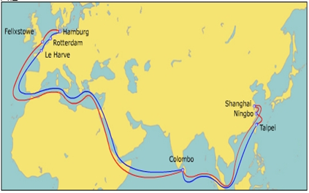
Routing Network
China-Europe Shuttle Service (CES)(NE8)
PORT | TERMINAL | ETA | ETD
TPE NBO SHG CMB | Taipei Port Container Terminal CORP. (TPCT) Ningbo Yining Terminal (Yining) Shanghai Sheng Dong (Yangshan) Sri Lanka Ports Authority (SLPA) | SUN MON WED SAT | MON WED FRI SUN
FLX HBG RDM LHV | Felixstowe Dock & Railway (Trinity) HHLA CTB Container Terminal (CTB) E.C.T. Delta Dedicated Terminals West (DDW) Terminal de France (TDF) | TUE FRI MON WED | WED SUN WED THU
Direct service from Taiwan, E.China, Colombo to Europe.
Fleet deployment: 10 x 8,500 TEUs Joint with Cosco, YML, Hanjin.
Effective Vessel: CES 0339-001W, eta SHG Apr/20
T/S Time
W/B | FLX | HBG | RDM | LHV
TPE | 29 | 31 | 34 | 37
NBO | 27 | 29 | 32 | 35
SHG | 25 | 27 | 30 | 33
CMB | 16 | 18 | 21 | 24

Slide 4
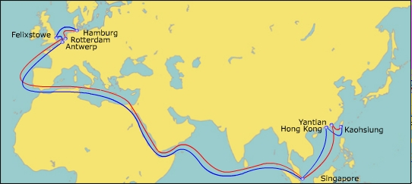
Routing Network
North Europe Express Service 2 (NE2)
PORT | TERMINAL | ETA | ETD
HKG KSG YYT SGP | HIT Kao Ming CNTR Terminal #108 Yantian International Terminal (YICT) Pasier Panjang Terminal (PSA) | SAT TUE THU MON | SAT WED FRI WED
RDM HBG FLX ANW | Euromax HHLA CTT Container Terminal (CTT) Felixstowe Dock & Railway (Trinity) PSA HNN Deurganck Terminal Quay 1742 | MON WED FRI SUN | TUE THU SUN MON
T/S Time
POL direct service from Kaohsiung、Yantian and Singapore to Europe.
Quick t/s time.
Fleet deployment: 10 x 8,500TEU, operated by K-line and YML
Effective Vessel:
W/B | RDM | HBG | FLX | ANW
HKG | 29 | 31 | 33 | 35
KSG | 26 | 28 | 30 | 32
YYT | 24 | 26 | 28 | 30
SGP | 19 | 21 | 23 | 25
4

Slide 5
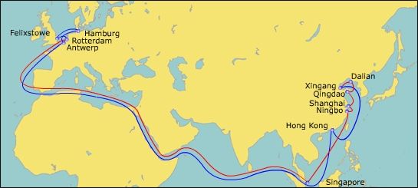
Routing Network
North Europe Express Service 3 (NE3)
PORT | TERMINAL | ETA | ETD
XGA DLI QND SHG NBO SGP | Tianjin Port Container Terminal (TPCT) Dalian Port Container Terminal (DPCM) Qingdao Qianwan CNTR Terminal (QQCT) Shanghai Sheng Dong International (Yangshan) Ningbo Yuan Dong Terminal (Yuan Dong) Pasier Panjang Terminal (PSA) | SUN TUE THU SAT SUN SAT | TUE WED FRI SUN MON SUN
RDM FLX HBG ANW | Euromax Felixstowe Dock & Railway (South Terminal) HHLA CTT Container Terminal (CTT) Antwerp Gateway (AGT) | SUN TUE FRI MON | TUE THU SUN TUE
T/S Time
Direct service from North China (direct call Xingang, Qingdao, Dalian) to Europe.
Revise rotation as RDM first calling.
Fleet deployment: 11 x 13,000TEU operated by Cosco.
W/B | RDM | FLX | HBG | ANW
XGA | 35 | 37 | 40 | 43
DLI | 33 | 35 | 38 | 41
QND | 31 | 33 | 36 | 39
SHG | 29 | 31 | 34 | 36
NBO | 28 | 30 | 33 | 36
SGP | 22 | 24 | 27 | 30

Slide 6
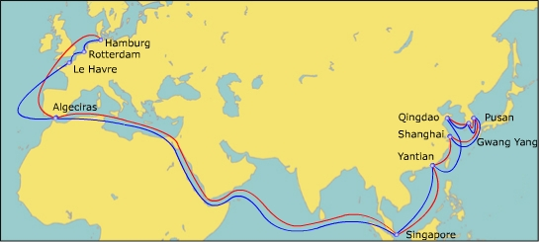
Routing Network
Asia-North Europe Service 6 (NE6)
PORT | TERMINAL | ETA | ETD
QND KPQ PUS SHG YYT SGP | Qingdao Qianwan CNTR Terminal (QQCT) Hanjin Shipping Gwang Yang Terminal (HSGT) Hanjin Newport Shanghai Guan dong International (Yangshan) Yantian International Terminal (YICT) Pasier Panjang Terminal (PSA) | SAT TUE TUE FRI MON FRI | SUN TUE WED SAT TUE SAT
AGC HBG RDM LHV | Total Terminal International Algeciras Eurogate Euromax Terminal de France (TDF) | TUE SUN WED FRI | WED TUE THU SAT
T/S Time
Direct service from North China (Qingdao direct call), Korea (Pusan, Gwang Yang) to Europe.
Direct call Algeciras for W.Africa market
Fleet deployment: 11 x 13,000TEU, operated by Hanjin.
Effective Vessel: HJUK 0014W, eta QND 4/19
W/B | AGC | HBG | RDM | LHV
QND | 30 | 35 | 38 | 40
KPQ | 28 | 33 | 36 | 38
PUS | 27 | 32 | 35 | 37
SHG | 24 | 29 | 32 | 34
YYT | 21 | 26 | 29 | 31
SGP | 17 | 22 | 25 | 27

Slide 7
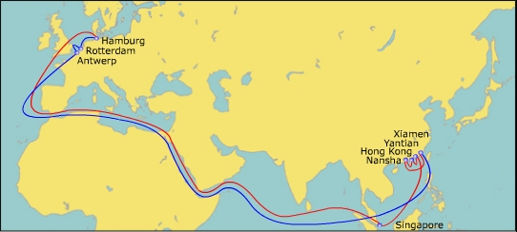
Routing Network
South China Express Service (NE7)
PORT | TERMINAL | ETA | ETD
XSM XTH HKG YYT SGP | Xiamen Ocean Gate Terminal Guang Zhou South China Ocean Gate Terminal HIT Yantian International Terminal (YICT) Pasier Panjang Terminal (PSA) | MON WED THU SAT WED | TUE THU FRI SUN THU
HBG RDM ANW | HHLA CTT Container Terminal (CTT) Euromax PSA HNN Deurganck Terminal Quay 1742 | FRI MON WED | SUN TUE THU
T/S Time
Direct service from South China ( direct call Xiamen, Nansha, Hong Kong and Yantian ) to Europe.
Fleet deployment: 10X8,000TEU, joint with Cosco, K-line, YML.
Effective Vessel:
W/B | HBG | RDM | ANW
XSM | 31 | 34 | 36
XTH | 29 | 32 | 34
HKG | 28 | 31 | 33
YYT | 26 | 29 | 31
SGP | 22 | 25 | 27

Slide 8
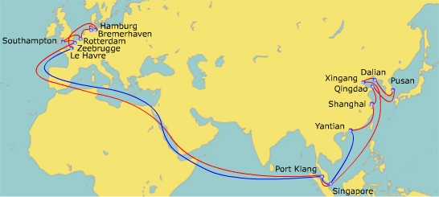
Routing Network
Europe French-Asia Line (FAL3)
PORT | TERMINAL | ETA | ETD
XGA DLI PUS QND SHG YYT SGP PKL | Five Continents International (FICT) Dalian Port Container Terminal (DPCM) Busan New Container Terminal (BNCT ) Qingdao Qianwan CNTR Terminal (QQCT) Shanghai Guandong International (Yangshan) Yantian International Terminal (YICT) Pasier Panjang Terminal (PSA) Westports (WPT1) | THU SAT MON WED SAT MON FRI SUN | FRI SAT TUE THU SUN TUE SAT SUN
LHV HBG BHV RDM SOU ZEE | Terminal de France (TDF) HHLA Container Terminal (CTB) Eurogate Bremerhaven (CTB) E.C.T. Delta Dedicated Terminal West (DDW) DP World Southampton (SCT) Container Handling Zeebrugge (CHZ-Z206) | THU SAT MON WED FRI SAT | FRI MON TUE THU SAT SUN
T/S Time
W/B | LHV | HBG | BHV | RDM | SOU | ZEE
XGA | 34 | 36 | 38 | 40 | 42 | 43
DLI | 32 | 34 | 36 | 38 | 40 | 41
PUS | 30 | 32 | 34 | 36 | 38 | 39
QND | 28 | 30 | 32 | 34 | 36 | 37
SHG | 25 | 27 | 29 | 31 | 33 | 34
YYT | 23 | 25 | 27 | 29 | 31 | 32
SGP | 19 | 21 | 23 | 25 | 27 | 28
PKL | 18 | 20 | 22 | 24 | 26 | 27
The direct service from North China (direct call Xingang, Qingdao, Dalian) to Europe .
Direct service call Bremerhaven, Southampton, Zeebrugge.
Fleet deployment: 1 x 13,830 TEU+11X11,040TEU, operated by CMA.

Slide 9
T/S Time in FE-EUR W/B
W/B | SVC | ETA | ETD | RDM | HBG | BHV | LHV | ANW | ZEE | FLX | SOU
PUS | FAL3 | MON | TUE | 36 | 32 | 34 | 30 |  | 39 |  | 38
 | NE6 | TUE | WED | 35 | 32 |  | 37
KPQ | NE6 | SUN | MON | 36 | 33 |  | 38
XGA | FAL3 | THU | FRI | 40 | 36 | 38 | 34 |  | 43 |  | 42
 | NE3 | SUN | TUE | 35 | 40 |  |  | 43 |  | 37
DLI | FAL3 | SAT | SAT | 38 | 34 | 36 | 32 |  | 41 |  | 40
 | NE3 | TUE | WED | 33 | 38 |  |  | 41 |  | 35
QND | FAL3 | WED | THU | 34 | 30 | 32 | 28 |  | 37 |  | 36
 | NE3 | THU | FRI | 31 | 36 |  |  | 39 |  | 33
SHG | CEM | WED | THU | 32 | 37 |  |  |  |  | 34
 | CES | WED | FRI | 30 | 27 |  | 33 |  |  | 25
 | FAL3 | SAT | SUN | 31 | 27 | 29 | 25 |  | 34 |  | 33
 | NE3 | SAT | SUN | 29 | 33 |  |  | 36 |  | 31
 | NE6 | FRI | SAT | 32 | 29 |  | 34

Slide 10
T/S Time in FE-EUR W/B
W/B | SVC | ETA | ETD | RDM | HBG | BHV | LHV | ANW | ZEE | FLX | SOU
NBO | CEM | THU | SAT | 27 | 32 |  |  |  |  | 29
 | CES | MON | WED | 32 | 29 |  | 35 |  |  | 27
 | NE3 | SUN | MON | 28 | 33 |  |  | 36 |  | 30
XSM | NE7 | MON | TUE | 34 | 31 |  |  | 36
YYT | FAL3 | MON | TUE | 29 | 25 | 27 | 23 |  | 32 |  | 31
 | NE6 | MON | TUE | 29 | 26 |  | 31
 | NE7 | SAT | SUN | 29 | 26 |  | 31
 | NE2 | THU | FRI | 24 | 26 |  |  | 30 |  | 28
XHK | CEM | SUN | MON | 25 | 30 |  |  |  |  | 27
XTH | NE7 | WED | THU | 32 | 29 |  |  | 34
HKG | NE7 | THU | FRI | 31 | 28 |  |  | 33
 | NE2 | SAT | SAT | 29 | 31 |  |  | 35 |  | 33

Slide 11
Port Code
POL
POD
NBO: Ningbo
SHG: Shanghai
YYT: Yantian
XSM: Xiamen
XHK: Shekou
DLI: Dalian
XGA: Xingang
QND: Qingdao
XTH: Nansha
HKG: Hong Kong
KSG: Kaohsiung
TPE: Taipei
PUS: Pusan
KPQ: Gwang Yang
SGP: Singapore
PKL: Port Klang
PTP: Tanjung Peiepas
CMB: Colombo
HBG: Hamburg
BHV: Bremerhaven
RDM: Rotterdam
FLX: Felixstowe
SOU: Southampton
LHV: Le Havre
ZEE: Zeebrugge
ANW: Antwerp
AGC: Algeciras

Slide 12
Feeder Connection
POD | Mother VSL | T/S Port (ETA T/S port) | Dedicated Feeder Service (ETA T/S port) | T/S Time
ANTWERP | CES,CEM, FAL3, NE6 | Rotterdam | By barge with t/s time 2 days NE2,NE3 n NE7 are direct services
ZEEBRUGGE | CES, CEM | Rotterdam | FAL3,FAL3 are direct services
 | NE2, NE3,NE6,NE7 | Antwerp | By barge with t/s time 2 days, FAL3 are direct services
ST. PETERSBURG (PLP, FCT) | CEM, NE2 | Hamburg (WED) | BAL1(Fri) | 7
 | CES,NE3,NE7 | Hamburg (FRI) | BAL1(Fri) | 11
 | FAL3 | Hamburg (SAT) | BAL1(Fri) | 10
 | NE6 | Hamburg (SUN) | BAL1(Fri) | 9
 | CEM, NE2 | Hamburg (WED) | BAL3(Sun) | 8
 | CES,NE3,NE7 | Hamburg (FRI) | BAL3(Sun) | 7
 | FAL3 | Hamburg (SAT) | BAL3(Sun) | 6
 | NE6 | Hamburg (SUN) | BAL3(Sun) | 11
AARHUS COPENHAGEN | CES, NE3, NE7 | Hamburg (FRI) | NDS1 (Mon) (SAT) | 3~5
 | CEM, NE2 | Hamburg (WED) | NDS1 (Mon) (SAT) | 5~7
 | FAL3 | Hamburg (SAT) | NDS1 (Mon) (SAT) | 4~9
 | NE6 | Hamburg (SUN) | NDS1 (Mon) (SAT) | 3~8

Slide 13
Feeder Connection
POD | Mother VSL | T/S Port (ETA T/S port) | Dedicated Feeder Service (ETA T/S port) | T/S Time
OSLO FREDRIKSTAD KRISTIANSAND HELSINGBORG | CEM | Rotterdam (FRI) | NDS2 (TUE) | 6~8
 | CES, NE2, NE7 | Rotterdam (MON) | NDS2 (TUE) | 3~5
 | FAL3, NE6 | Rotterdam (WED) | NDS2 (TUE) | 8~10
 | NE3 | Rotterdam (SUN) | NDS2 (TUE) | 4~6
KOTKA HELSINKI | CEM | Rotterdam (FRI) | BAL2 (MON) (WED) | 6~10
 | CES, NE2, NE7 | Rotterdam (MON) | BAL2 (MON) (WED) | 6~10
 | FAL3, NE6 | Rotterdam (WED) | BAL2 (MON) (WED) | 8~12
 | NE3 | Rotterdam (SUN) | BAL2 (MON) (WED) | 3~8
BILBAO | CEM | Rotterdam (FRI) | IES1 (SAT) | 3
 | CES, NE2, NE7 | Rotterdam (MON) | IES1 (SAT) | 8
 | FAL3, NE6 | Rotterdam (WED) | IES1 (SAT) | 6
 | NE3 | Rotterdam (SUN) | IES1 (SAT) | 9

Slide 14
Feeder Connection
POD | Mother VSL | T/S Port (ETA T/S port) | Dedicated Feeder Service (ETA T/S port) | T/S Time
VIGO LEIXOES LISBON | CEM | Rotterdam (FRI) | IES2 (THU) (MON) | 6~9
 | CES, NE2, NE7 | Rotterdam (MON) | IES2 (THU) (MON) | 7~10
 | FAL3, NE6 | Rotterdam (WED) | IES2 (THU) (MON) | 5~8
 | NE3 | Rotterdam (SUN) | IES2 (THU) (MON) | 3~8
DUBLIN | CEM | Rotterdam (FRI) | RDX1 (5) | 4~7
 | CES, NE2, NE7 | Rotterdam (MON) | RDX1 (4) | 4~8
 | FAL3, NE6 | Rotterdam (WED) | RDX1 (7) | 6~9
 | NE3 | Rotterdam (SUN) | RDX1 (4) | 5~9
GOTHENBURG | CEM | Rotterdam (FRI) | IES1 (SAT) (TUE) | 4~7
 | CES, NE2, NE7 | Rotterdam (MON) | IES1 (SAT) (TUE) | 4~8
 | FAL3, NE6 | Rotterdam (WED) | IES1 (SAT) (TUE) | 6~8
 | NE3 | Rotterdam (SUN) | IES1 (SAT) (TUE) | 5~9
14

Slide 15
Feeder Connection
POD | Mother VSL | T/S Port | (T/S Time) | Common Feeder
GDYNIA GDANSK SZCZECIN | CEM | Rotterdam (FRI) | 7 | V
 | CES, NE2, NE7 | Rotterdam (MON) | 7 | V
 | FAL3, NE6 | Rotterdam (WED) | 7 | V
 | NE3 | Rotterdam (SUN) | 7 | V
GRANGEMOUTH BELFAST CORK IMMINGHAM TEESPORT SOUTH SHIELD | CEM | Rotterdam (FRI) | 7 | V
 | CES, NE2, NE7 | Rotterdam (MON) | 7 | V
 | FAL3, NE6 | Rotterdam (WED) | 7 | V
 | NE3 | Rotterdam (SUN) | 7 | V
TALLINN | CEM, NE2 | Hamburg (WED) | 7 | V
 | CES,NE3,NE7 | Hamburg (FRI) | 7 | V
 | FAL3 | Hamburg (SAT) | 7 | V
 | NE6 | Hamburg (SUN) | 7 | V

Slide 16
Feeder Connection
POD | Mother VSL | T/S Port | (T/S Time) | Common Feeder
RIGA | CEM | Rotterdam (FRI) | 7 | V
 | CES, NE2, NE7 | Rotterdam (MON) | 7 | V
 | FAL3, NE6 | Rotterdam (WED) | 7 | V
 | NE3 | Rotterdam (SUN) | 7 | V
KLAIPEDA | CEM | Rotterdam (FRI) | 7 | V
 | CES, NE2, NE7 | Rotterdam (MON) | 7 | V
 | FAL3, NE6 | Rotterdam (WED) | 7 | V
 | NE3 | Rotterdam (SUN) | 7 | V

